Slide 1
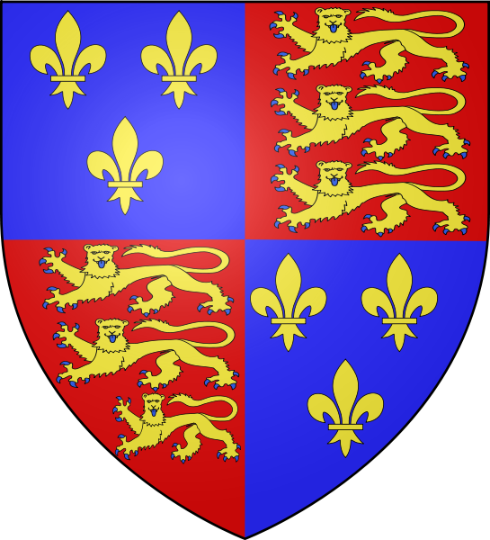
The Stuarts
James I, the Gunpowder Plot
Charles I, the Civil War
Oliver Cromwell, the Commonwealth
Charles II, the Plague, the Great Fire of London, St Paul’s Cathedral
James II
William and Mary
Anne

Slide 2
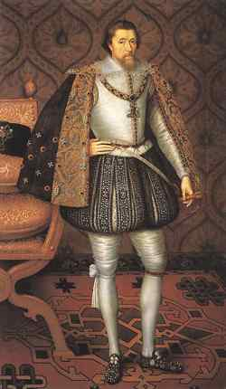
King James I (1603-1625) (James VI of Scotland)
He believed he was king by God’s will and he expected Parliament to obey him without any question
He entertained so magnificently that he was often short of money. He had to ask Parliament for money to wage wars. This made him unpopular
During his reign there were two main problems: the Power of Parliament and religion

Slide 3
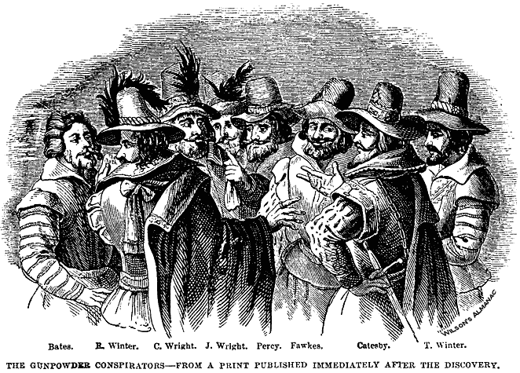
The Gunpowder Plot
James had been sympathetic to Catholics. His wife was a Catholic but now he needed the support of the Puritan nobility. So, he declared that he detested Catholicism and had all priests expelled.
Agroup of Roman Catholic nobles, led by a Catholic soldier Guy Fwakes, plotted to blow up Parliament and kill the king. It took place on 5ht November in 1605.
The plot was discovered. All the plotters were arrested and then hung and quartered

Slide 4
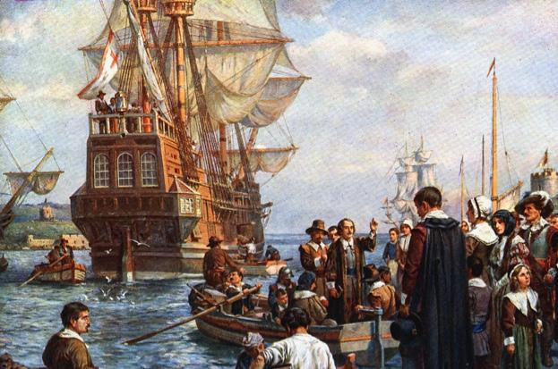
The Pilgrim Fathers
Like the Catholics, the Puritans were not allowed to worship as they wished. In 1620 they sailed across the Atlantic and set up home in America.
The Mayflower

Slide 5
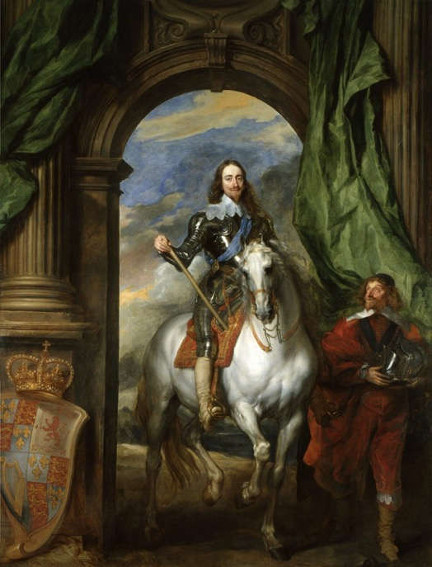
Charles I (1625-1649)
He was very clever, good at languages, but he was also weak and sickly. He stuttered.
He inherited a country with money problems. He didn’t have the support of Parliament to raise money for his own expenses and wars. He demanded taxes without Parliament’s permission.
In 1642 he declared the war on the Parliamentarians. Charles’s supporters were called the “Royalists”.

Slide 6
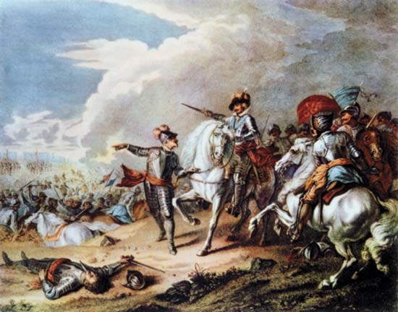
The English Civil War (1642-1648)
When the Civil War began people had to choose sides. Some families were divided fighting on opposite sides.

Slide 7
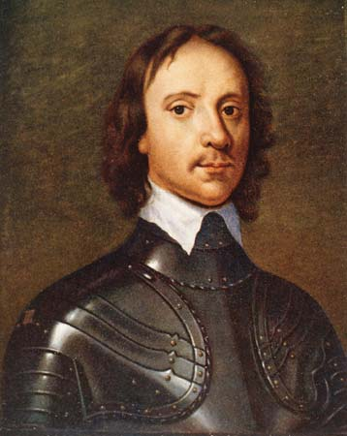
Oliver Cromwell
He tried to make a deal with Charles, but when the king continued to rebel he decided to arrest him and put him on trial for treason.
Defeated the supporters of the king's son Charles II. It meant the triumph of Parliament

Slide 8
The Execution of the King and The Commonwealth
The king was sentenced to death
Britain became a republic, called the Commonwealth.
Cromwell ruled as Lord Protector.
He was a Puritan and passed lawas that many people disliked and wanted a return to things as they used to

Slide 9
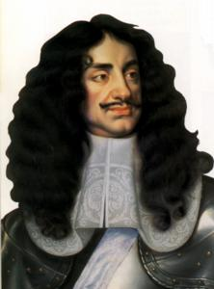
Charles II (1660-1685) Restoration of the Monarchy
The army invited Charles I’s son to return from abroad to become King Charles II.
He was known as “the Merry Monarch”
He strengthened the Church of England and passed laws discriminating the Catholics.
Converted to Roman Catholicism on his deathbed

Slide 10
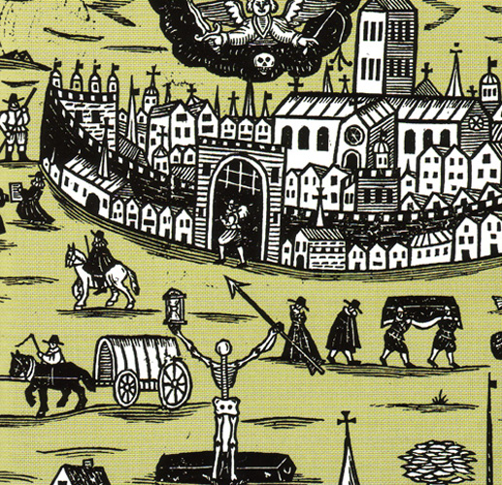
The Great Plague of London
The summer of 1665 was unusually hot.
A terrible plague struck London killing about 110,000 people
It is believed to be spread by fleas carried on black rats.
“Bring out your dead”!

Slide 11
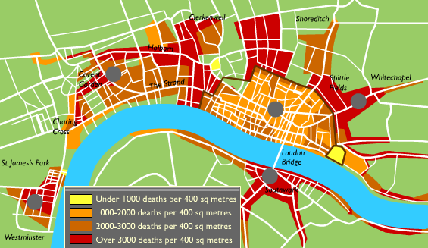
The Great Plague of London

Slide 12
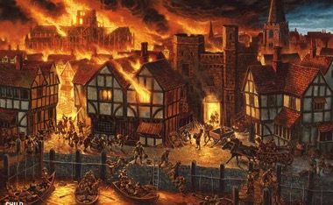
The Great Fire of London
In the year following the plague, a second disaster struck London. A fire broke out in a baker’s shop in Pudding Lane
London was built of wood. So fires spread quickly
6 people died
80% of the city was destroyed: 13,000 houses;
89 churches; 52 Guild Halls

Slide 13
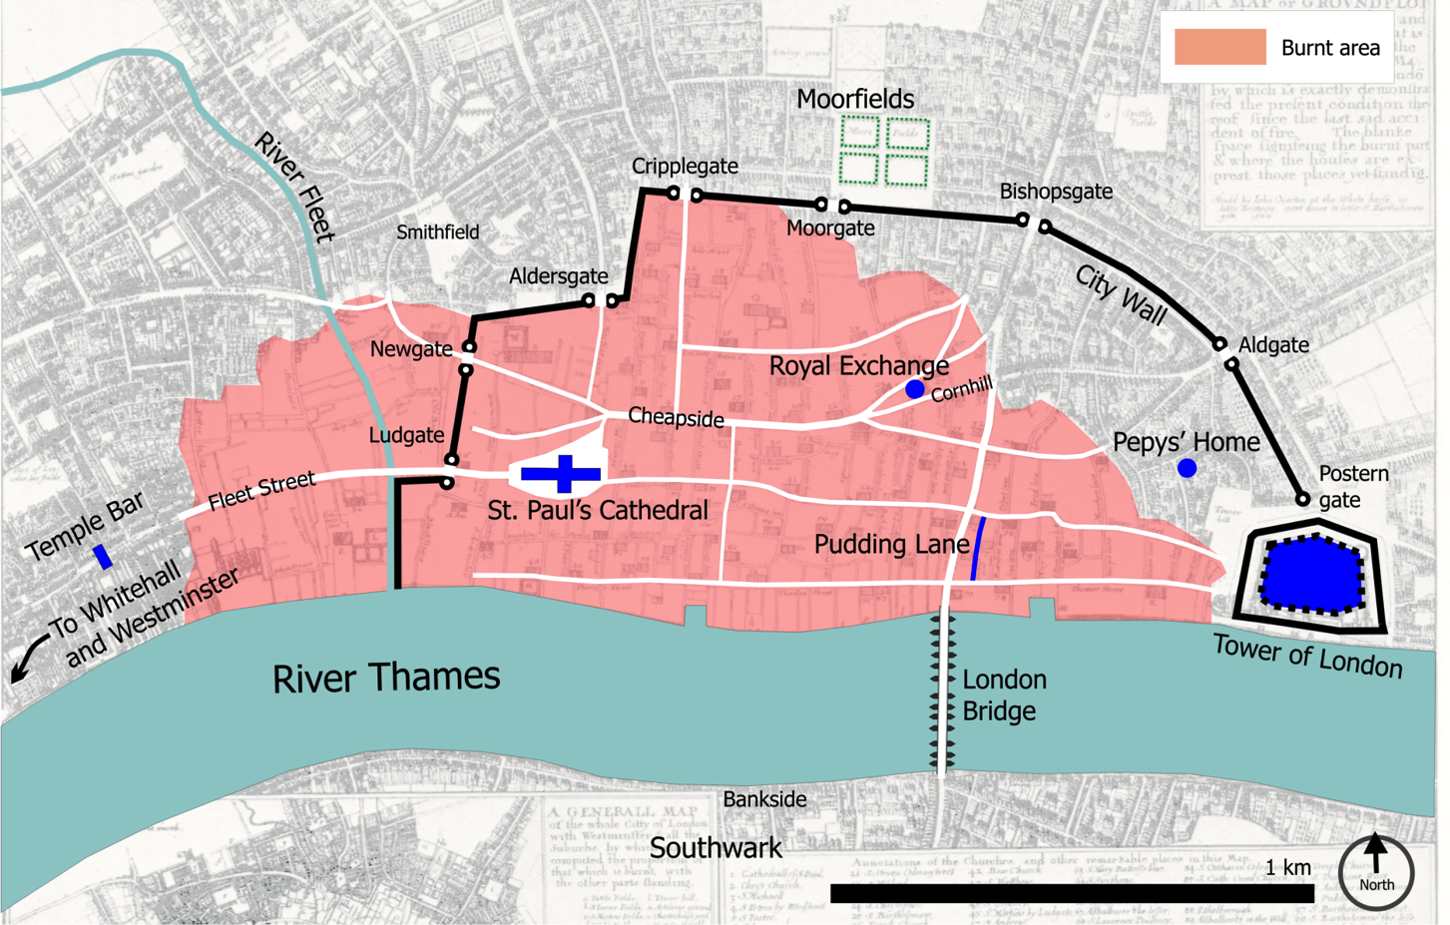
The Great Fire of London

Slide 14
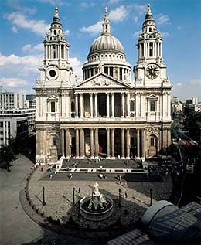
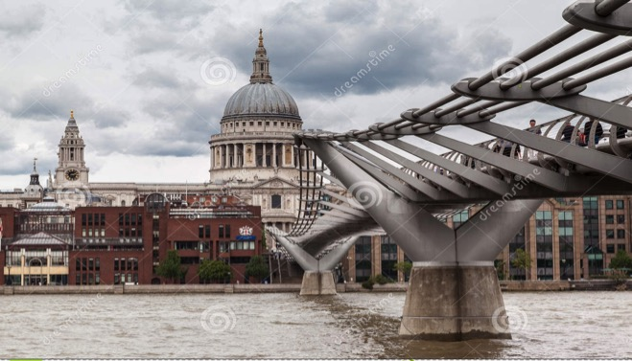
St Paul’s Cathedral
Much of London had been destroyed. The king called on an architect, Sir Christopher Wren, to design a new city.
His masterpiece was St Paul’s Cathedral

Slide 15
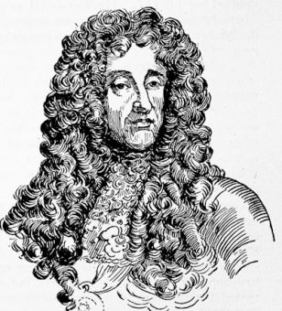
James II (1685-1688)
He was a Catholic and soon began to put Catholics in positions of power in the army and government
This worried the protestants, who offered the crown to Mary, James’s Protestant daughter and her husband, William

Slide 16
William and Mary (1688-1702)
When they came to the throne Parliament drew up a list of rules to control their power.

Slide 17
Anne (1702-1714)
When William died, James II’s other daughter Anne became queen.
During her reign Parliament began to divide into two parties, the Whigs and the Tories.

Slide 18
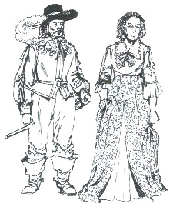
Daily Life in The Stuarts
Fashions became more colourful
Most people still worked on the land, but industry was becoming more important
The fastest growing industry was coal. The iron industry, glass making and salt mining were also important
Small boys worked in the capital sweeping chimneys
There wasn’t much personal hygiene. People cleaned their teeth with salt on their finger
Beer was drunk more than milk or water
The poor ate mostly vegetables and oysters, which were cheap.

Slide 19
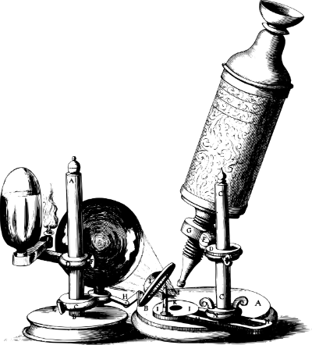
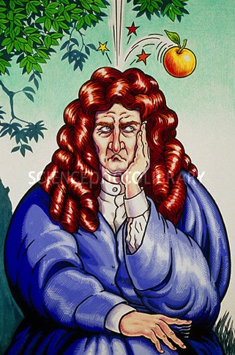
Life in the 17th century
Science
Philosophy
Witchcraft
Art: literature, painting, music

